Slide 1
WEB PROJECT
PROPOSAL

Slide 2
TABLE OF CONTENTS
01
04
About the Project
Sneak Peek
02
05
Major Requirements
Project Stages
03
06
Project Goals
Our Team
Lunch-Box A Visionary Idea To Serve The Homemade Food Online.
Minimal Cost Service For Students And Professionals
Here you could describe
the topic of the section
Mainly 3 Stages Are There
To Provide The Quality Food At Minimal Cost.
Team Lunch-Box

Slide 3
OUR COMPANY
Lunch-Box
Lunch-Box’s Focus Is To Provide The Quality Food At The Reasonable Cost. No Other Website Provides You The Infrastructure Of Ordering The Tiffin-Box. A Small Town Service Of Tiffin-Box Which Will Be Going To Make A Revolutionary Change In Food Services!

Slide 4
WHAT WE ARE WORKING ON
SECURE
ACCESSIBLE
FAST AND RELIABLE
Every Customer Detail Is Encrypted
Easily Accessible And Simple Interface
Realiable Cost With Fast Service

Slide 5
ABOUT THE PROJECT
Most Of the Giant Startups Like Zomato, Swiggy are currently running but there prices are 200% high as compare to our service. And Our Quality Of Food Is 10 times better then all services are currently running in market.
“We Trust On Quality!”

Slide 6
FUTURE
BRANDING
POSITIONING
ADAPTABILITY

Slide 7
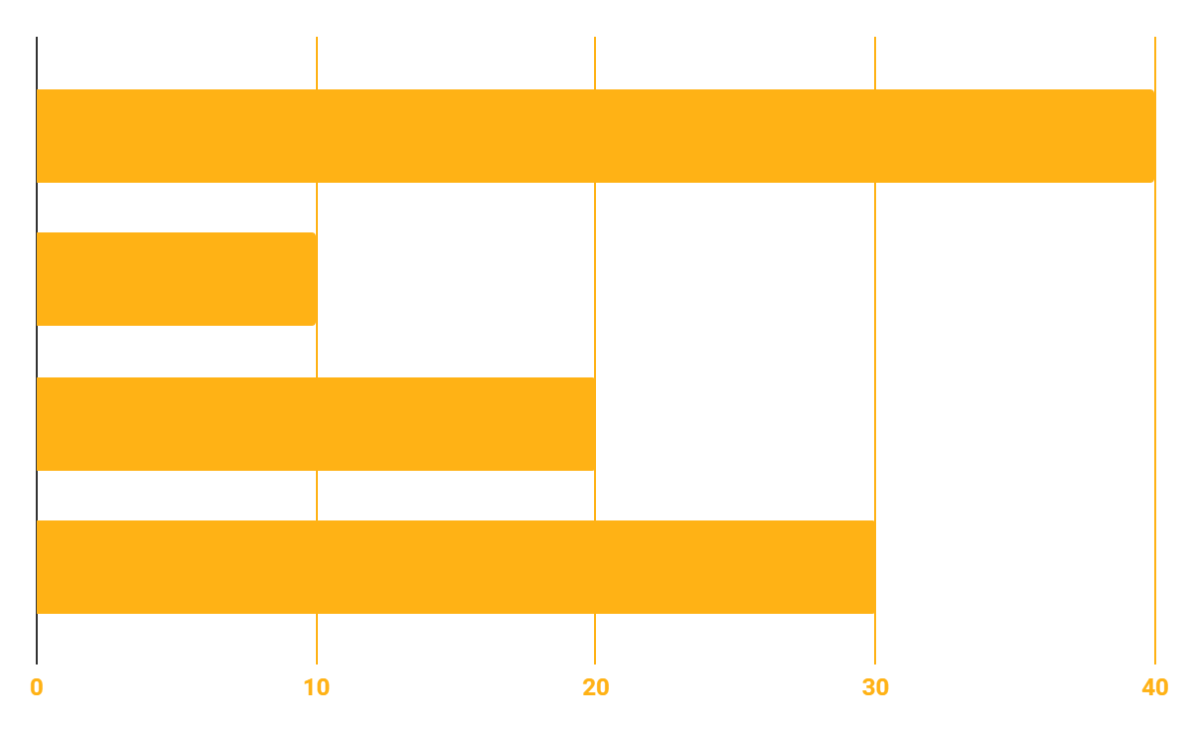
BUDGET
10%
40%
PROGRAMMING
20%
30%
DATABASE
WEB DESIGN
UX RESEARCH

Slide 8
OUR GOALS
EXPANSION
POSITIONING
USABILITY
Neptune is the fourth-largest planet in our Solar System
Venus has a beautiful name and is the second planet from the Sun
Despite being red, Mars is a cold place, not hot. It’s full of iron oxide dust

Slide 9
SNEAK PEEK
HEADER DESIGN
INTERFACEFEATURES
SLIDER BAR
KITCHEN KING

Slide 10
PROJECT STAGES
STEP 2
STEP 1
STEP 3
Venus has a beautiful name and is the second planet from the Sun
Despite being red, Mars is a cold place, not hot. It’s full of iron oxide dust
Saturn is a gas giant, composed mostly of hydrogen and helium

Slide 11
OUR PARTNERS
KITCHEN
MOM’S MAGIC
VOID
Void Technical Is An CyberSecurity Service
Kitchen-King a Online Brand For Papad Making
Mom’s Magic Is A Tiffin Service Of Small Town

Slide 12
POSITIONING
Do You Have Any Questions?
+91 7806073639
sanskardhanotiya108@gmail.com

